Slide 1
More DOM Information
Accessing Nodes | Modifying DOM Structure
Notes:
Welcome to our lecture on further information on DOM. In this lecture we will go through how to access nodes, and how to modify DOM structure. Let’s start our lecture.

Slide 2
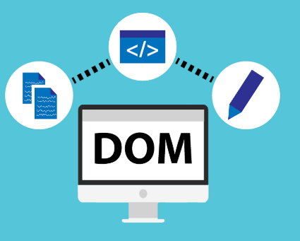
Accessing Nodes
The document.documentElement object is the DOM tree's root. Ex: let html = document.documentElement; assigns the root node. DOM nodes have properties to access their parent, children, and siblings:
parentNode refers to a node's parent. Ex: <ol> is the parent of <li> nodes.
childNodes is a collection of a node's children. Ex: <li> and text nodes are <ol>'s children.
Notes:
Now let us explore how to access nodes in the DOM. The document Element property represents the root node of the document. Each node has properties to navigate its structure. The parent Node property lets us access an element’s parent while child Nodes returns a collection of its child elements. Understanding these relationships helps us traverse and manipulate the DOM efficiently using JavaScript.

Slide 3
Accessing Nodes
children is like childNodes but excludes text nodes. Ex: <li> nodes are <ol>'s children.
nextElementSibling refers to the next sibling element. Ex: <ol> is the next sibling of <p>.
previousElementSibling refers to the previous sibling element. Ex: <p> is the previous sibling of <ol>.
Notes:
Now let us explore more ways to access nodes in the DOM. The children property retrieves only element nodes excluding text nodes. The next Element Sibling property helps navigate to the next sibling element while previous Element Sibling moves to the previous sibling. These properties allow precise navigation through the DOM structure making it easier to manipulate webpage elements dynamically.

Slide 4
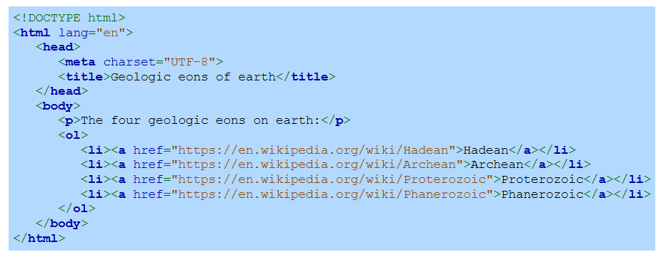
Example
Notes:
Now let us look at an example of accessing and organizing DOM elements. The HTML structure contains a paragraph and an ordered list with links to different geologic eons. Using JavaScript, we can traverse this structure selecting elements such as list items or links using properties like children and next Element Sibling. This method helps dynamically interact with and modify webpage content efficiently.

Slide 5


Modifying the DOM structure
appendChild(node) adds a node to the end of a parent’s children.
insertBefore(newNode, refNode) inserts a node before a specified child.
removeChild(node) removes a child node from its parent.
Notes:
Now let us explore modifying the DOM structure. The append Child method adds a new node at the end of a parent’s children. The insert Before method places a node before a specific element. The remove Child method deletes a child node from its parent. These methods allow dynamic updates to webpage content making it possible to add rearrange or remove elements interactively using JavaScript.

Slide 6
Modifying the DOM structure
The following methods are for creating new nodes or duplicating existing nodes:
createElement(tag) creates a new element node. Ex: document.createElement("p") → new <p> node.
createTextNode(text) creates a new text node. Ex: document.createTextNode("Hello there!") → text node.
cloneNode(deep) copies a node; true clones children, false clones only the node. Ex: x.cloneNode(true) → full copy, x.cloneNode(false) → single node copy.
Notes:
Now let us look at methods for creating and duplicating DOM nodes. The create Element method generates a new element while create Text Node creates a text node. The clone Node method copies an existing node where true clones all child elements and false copies only the selected node. These methods help dynamically modify webpage content by adding or duplicating elements as needed.

Slide 7
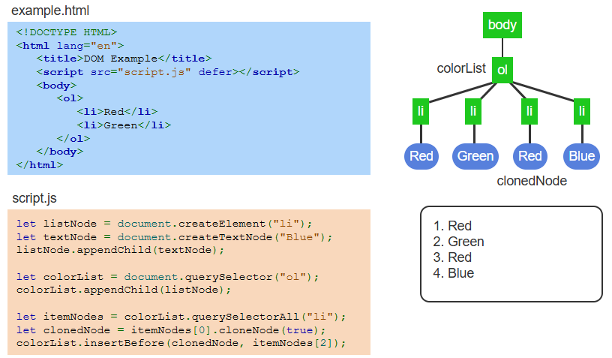
Example
Notes:
Now let us see an example of modifying the DOM dynamically. The JavaScript code creates a new list item with text and appends it to the ordered list. It then clones an existing list item and inserts it before another item. This demonstrates how JavaScript allows us to create update and duplicate elements dynamically making webpages more interactive and adaptable to user actions. Thanks for watching the lecture.

